Slide 1
Interference Level 4/5 Group 20 – Final Pitch
Max Carter (L5)
Charlie Crewe (L5)
Quwaine Dantes (L5)
Joe Sawyer (L4)
Ethan Ward (L4)

Slide 2
Logline
Survive waves of interference, through management and skill, to uncover memories of your past.

Slide 3
Demographic
Males (18-24)
Increased difficulty to evoke a Learn, Practice, Master loop
Hard fun - strategy, obstacles & goals – frustration & fiero
Serious fun – rhythm & repetition – zen focus

Slide 4
Obscure Sorrows
Adronitis - frustration with how long it takes to get to know someone
Amnesia causes the player character to not know himself
Monachopsis - the subtle but persistent feeling of being out of place
The player is in a coma, therefore they are feeling out of place

Slide 5
The Game
https://www.youtube.com/watch?v=x3zJs-Thmks

Slide 6
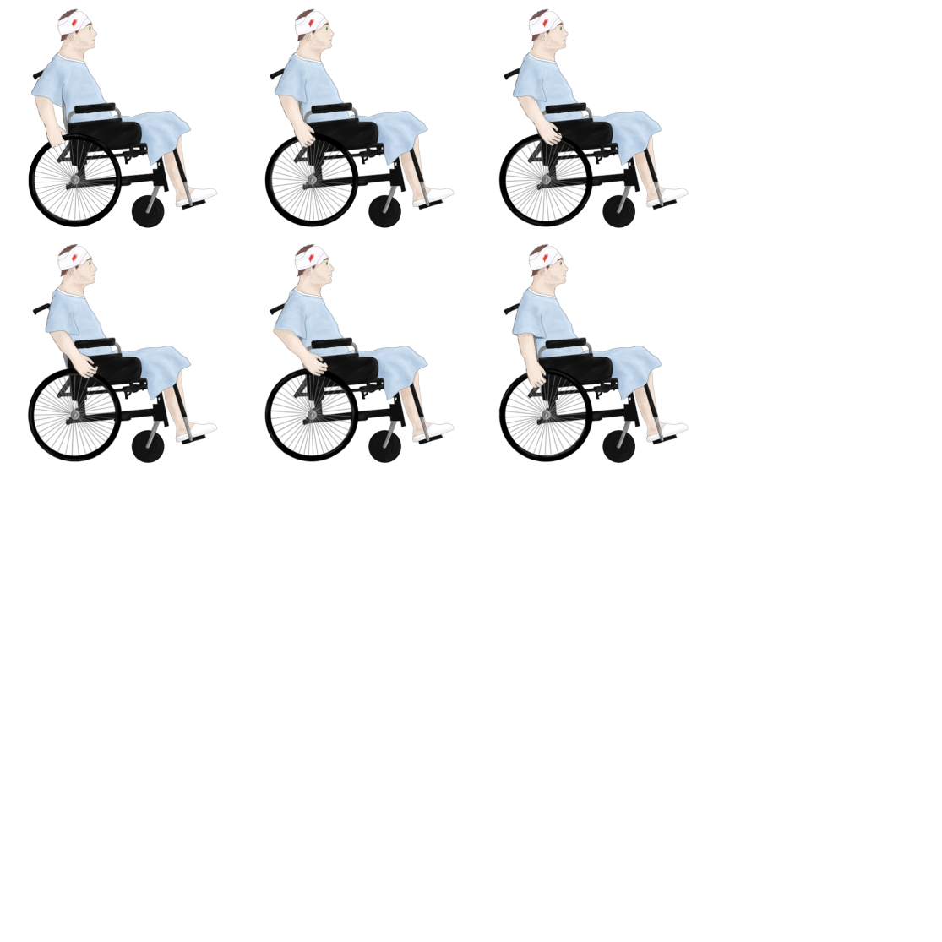
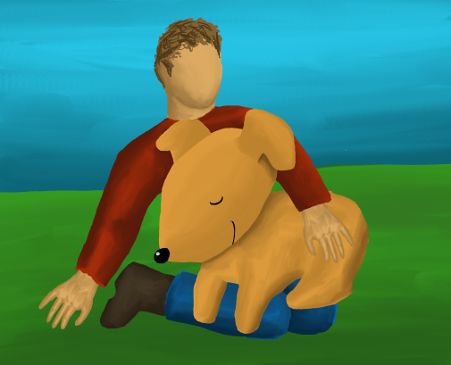


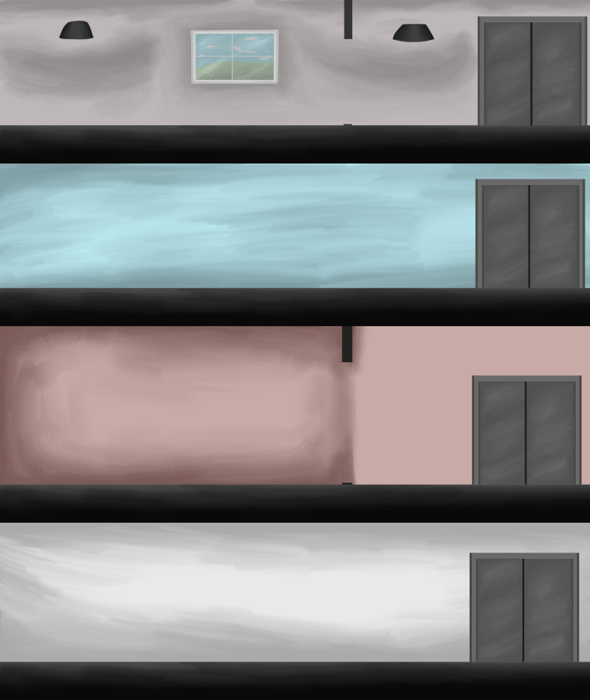
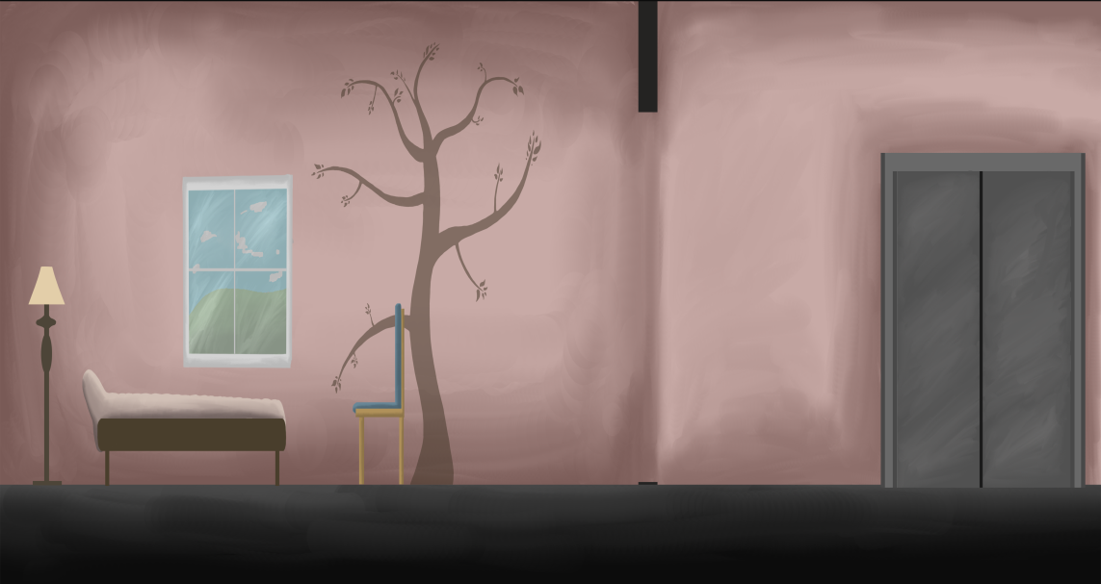
What’s Changed?

Slide 7
Things to take forward…
What we’ve learnt
Well
Communication
Meetings
Repository Organisation
Poorly
Scoping
Time Management
Taking Forward
Scoping
Group Communication

Slide 8
Project Analysis
Time worked:
Max – 46 hours 10 minutes (10 hours unrecorded from pre-sprints)
Charlie – 30 hours 30 minutes
Quwaine – 26 hours 15 minutes
Joe – 35 hours 55 minutes (10 hours unrecorded from pre-sprints)
Ethan – 34 hours 15 minutes (10 hours unrecorded from pre-sprints)
Emails sent:
Max – 120 emails
Charlie – 37 emails
Quwaine – 33 emails
Joe – 79 emails
Ethan – 36 emails

Slide 9
Thank you for listening!
Any questions?

